Slide 1

PFA House Price Prediction
By
Raviprasad Bathina

Slide 2
Problem Statement
Houses are one of the necessary need of each and every person around the globe
Hence housing and real estate market is one of the markets which is one of the major contributors in the world’s economy.
Data science comes as a very important tool to solve problems in the domain to help the companies increase their overall revenue, profits, improving their marketing
Predictive modelling, Market mix modelling, recommendation systems are some of the machine learning techniques used for achieving the business goals for housing companies.
Our problem is related to one such housing company.

Slide 3
EDA
1. Checking the Missing Values
2.All the numerical Variables
3.Distribution of the Numerical Variables
4.categorical variables
5. cardinality of the categorical variables
6.Outliers
7.Relationship between dependent and independent feature(SalePrice)

Slide 4
Checking the missing values
Missing values in Checking the missing values
Checking the missing values
Missing values in the dataset can be checked by below python code:-
## Here we will check the percentage of nan values present in each feature
## 1 -step make the list of features which has missing values
features_with_na=[features for features in df.columns if df[features].isnull().sum()>1]
## 2- step print the feature name and the percentage of missing values
for feature in features_with_na:
print(feature, np.round(df[feature].isnull().mean(), 4), ' % missing values')

Slide 5
Observation:-
Number of missing variable columns: 18 Missing values in the dataset :
LotFrontage 0.1832 % missing values
Alley 0.9341 % missing values
MasVnrType 0.006 % missing values
MasVnrArea 0.006 % missing values
BsmtQual 0.0257 % missing values
BsmtCond 0.0257 % missing values
BsmtExposure 0.0265 % missing values
BsmtFinType1 0.0257 % missing values
BsmtFinType2 0.0265 % missing values
FireplaceQu 0.4717 % missing values
GarageType 0.0548 % missing values
GarageYrBlt 0.0548 % missing values
GarageFinish 0.0548 % missing values
GarageQual 0.0548 % missing values
GarageCond 0.0548 % missing values
PoolQC 0.994 % missing values
Fence 0.7971 % missing values
MiscFeature 0.9623 % missing values

Slide 6
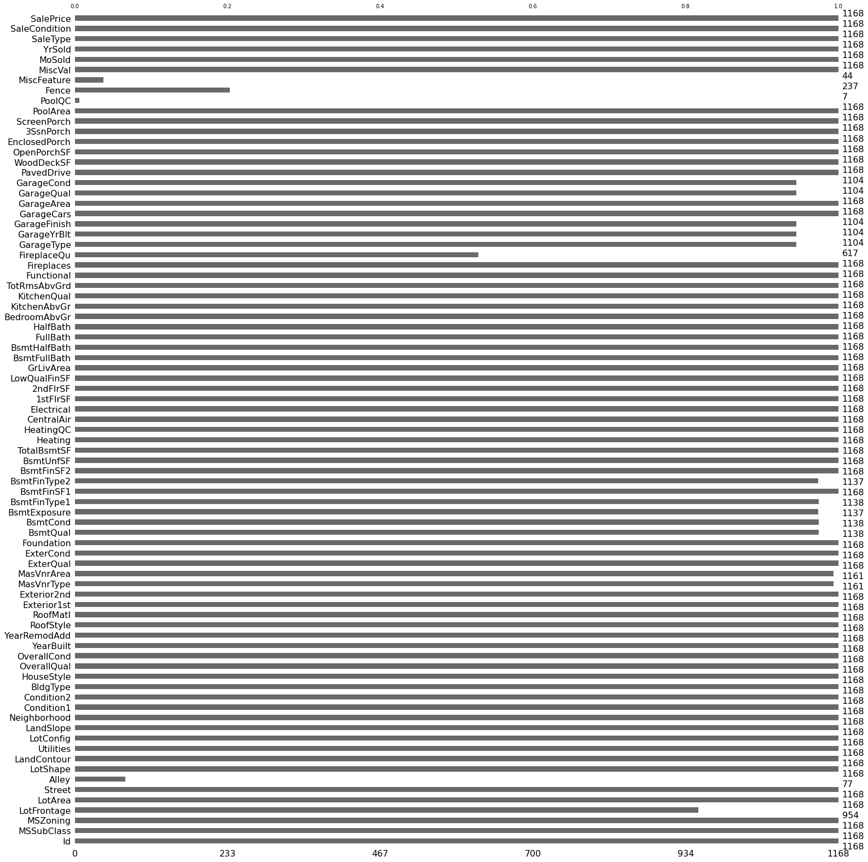
Checking the missing value with missingo library

Slide 7
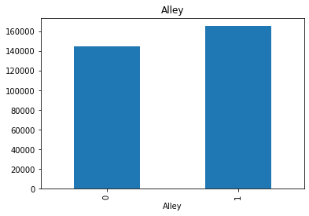
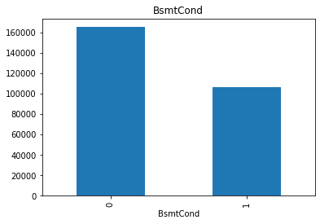
Representation Of Missing value Vs Saleprice
Missing value vs alley
Missing value vs Bsmtcond

Slide 8


Missing value vs BsmtFintype 1
Missing value vs bsmt Exposure

Slide 9
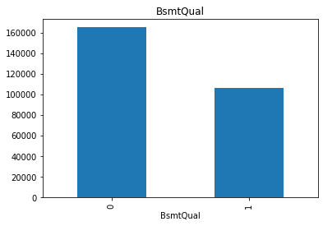

Missing value vs Bsmtqual
Missing value vs Bsmttype2

Slide 10
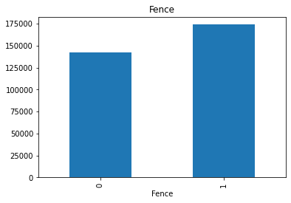
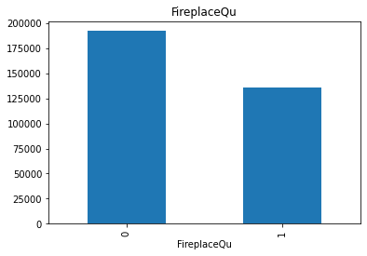
Missing value vs Fence
Missing value vs FireplaceQu

Slide 11
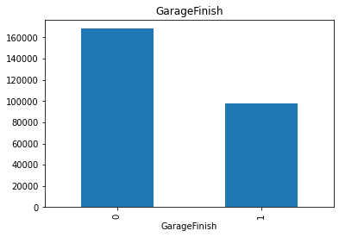

Missing value vs GarageCond
Missing value vs GarageFinish

Slide 12


Missing value vs GarageCond
Missing value vs GarageFinish

Slide 13
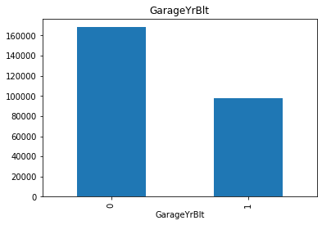
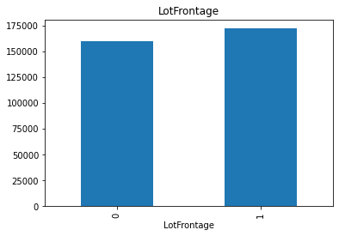
Missing value vs GarageQual
Missing value vs GarageYrBuilt

Slide 14


Missing value vs MassVnArea
Missing value vs MassVnType

Slide 15
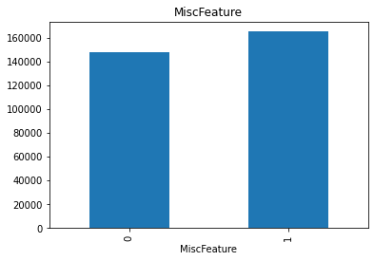
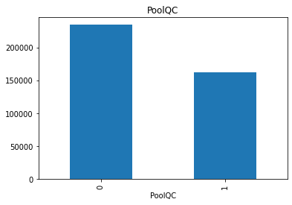
Missing value vs MiscFeature
Missing value vs PoolQC

Slide 16
Extracting the Numerical feature
Extracting all the numerical values using python code:-
numerical_features=[x for x in df.columns if df[x].dtypes != "O"]
print("The number of the numerical columns in the dataset:", len(numerical_features))
print("Numerical columns in the dataset:\n", numerical_features)
print("-"*125)
df[numerical_features].head()
Observation:-
1. 'YearBuilt','YearRemodAdd','GarageYrBlt','YrSold' are date columns we have in this dataset.
2. From the datatime column we usually extract the no of days, years, hours, minutes etc. hence this can be derived from the columns.

Slide 17
Extract the year column from the dataset
Extract the year column from the dataset using the python code:-
year_feature=[x for x in df.columns if 'Yr' in x or 'Year' in x]
print("The number of Year column in the dataset :",len(year_feature))
print("Year columns in the dataset :\n",year_feature)
print("-"*125)
df[year_feature].head()
Observation:-
1. 'YearBuilt','YearRemodAdd','GarageYrBlt','YrSold' are date columns we have in this dataset.
2. From the datatime column we usually extract the no of days, years, hours, minutes etc. hence this can be derived from the columns.

Slide 18
Checking the unique items in date time columns
Checking the unique items in datetime columns using the python code:-
# checking the unique items in the datetime columns
for feature in year_feature:
print("The unique items in the colunmn", feature, ":\n", df[feature].unique())

Slide 19
Relationship between feature and SalePrice
# relationship between year variables and SalePrice can be done using the python code
for feature in year_feature:
plt.figure(figsize=(8,6))
df.groupby(feature)['SalePrice'].median().plot()
plt.xlabel(feature)
plt.ylabel('SalePrice')
plt.show()

Slide 20
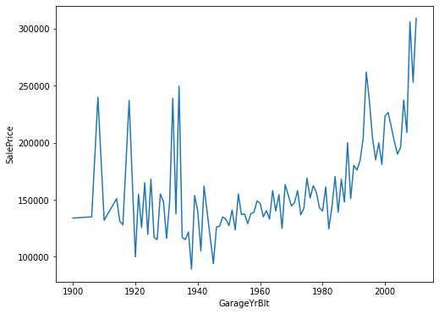
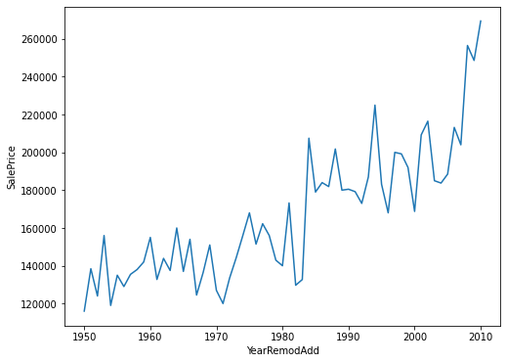
Data Visualization
SalePrice vs GarageBelt
YearRemodAdd vs SalePrice

Slide 21
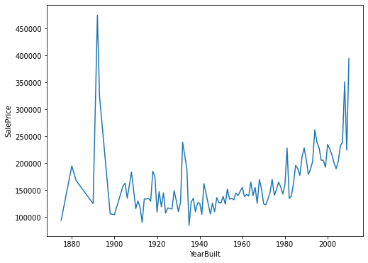
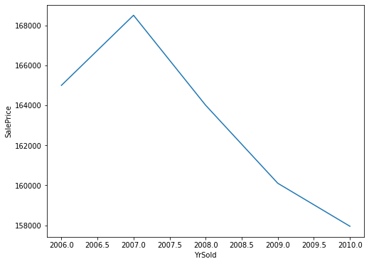
SalePrice vs YearBuilt
YrSold vs SalePrice

Slide 22
Extracting the discrete and continous variable
discrete_feature=[x for x in numerical_features if len(df[x].unique())<25 and x not in year_feature+['Id']]
print("The number of discrete column in the dataset:", len(discrete_feature))
print("Discrete columns in the datset: \n", discrete_feature)
print("-"*125)
df[discrete_feature].head()

Slide 23
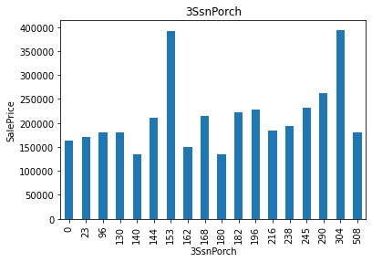
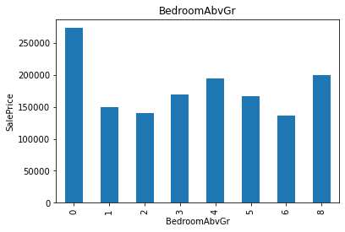
SalePrice vs 3SnPorch
SalePrice vs BedroomAbvGr

Slide 24
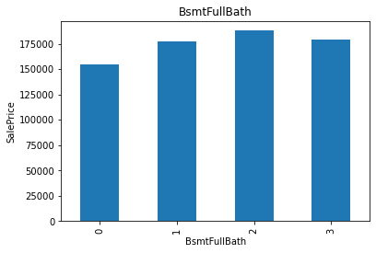
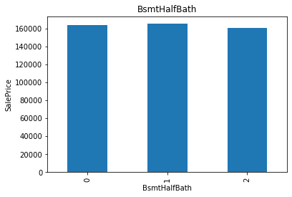
Saleprice vs bsmtFullBath
SalePrice vs BsmtHalf Bath

Slide 25
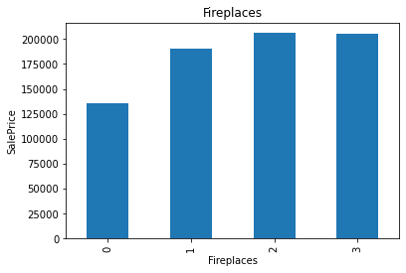
Saleprice vs FullBath
Saleprice vs Fireplaces

Slide 26
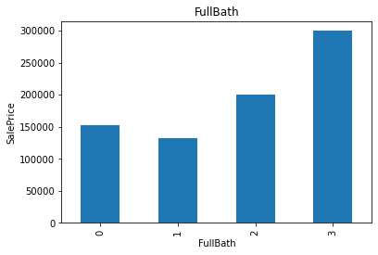
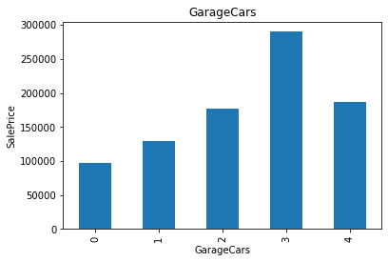
Saleprice vs FullBath
Salesprice vs GarageCars

Slide 27
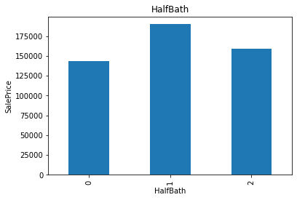
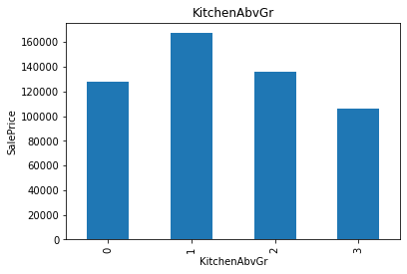
SalePrice Vs HalfBath
Saleprice Vs KitchenvGR

Slide 28
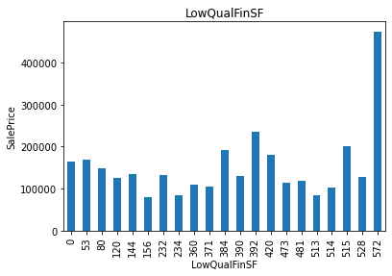
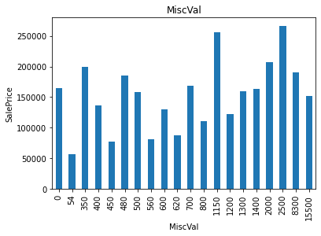
Saleprice Vs LowQualinSf
Saleprice vs MiscVal

Slide 29
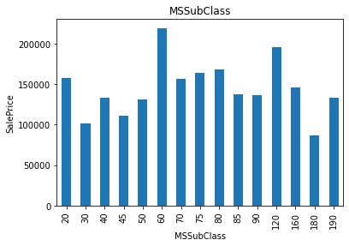
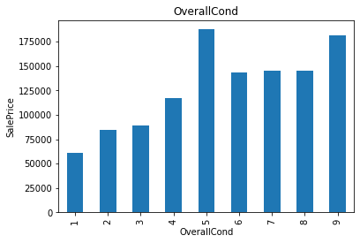
SalePrice Vs MSSubclass
Saleprice Vs Overcond

Slide 30
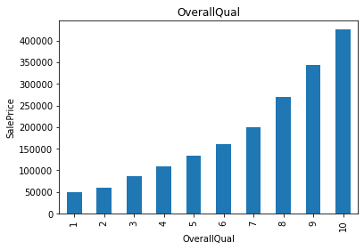
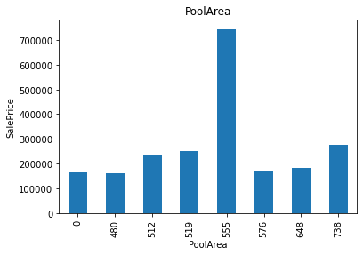
Saleprice vs OverallQual
SalePrice Vs PoolArea

Slide 31
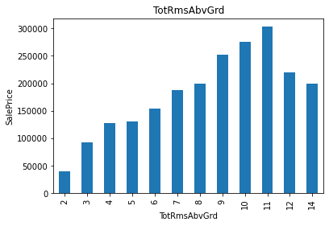
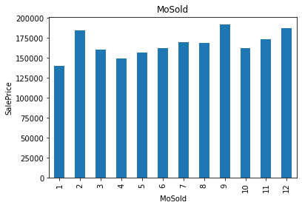
SalePrice Vs TotRmsAbv Grd
Saleprice vs Mosold

Slide 32
Extracting the continous variable
continous_feature=[x for x in numerical_features if x not in discrete_feature+year_feature+['Id']]
print("The number of continous feature column in the dataset :",len(continous_feature))
print("Continous feature columns in the dataset :\n",continous_feature)
print("-"*125)
df[continous_feature].head()
Observation:-
The number of continuous feature column in the dataset : 16

Slide 33
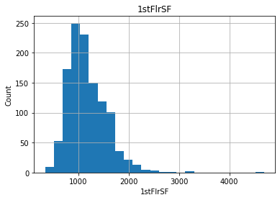
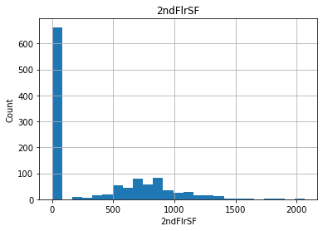
Histogram plot of 1stF1r
Histogram plot of 2ndF1r

Slide 34
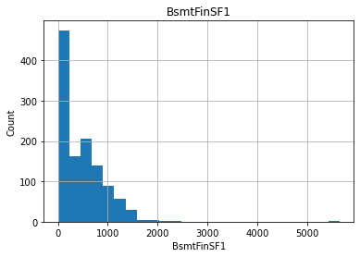
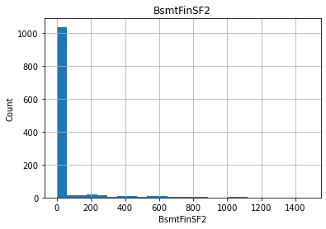
Histogram of BsmtFinSF1
Histogram of BsmtfinSF2

Slide 35
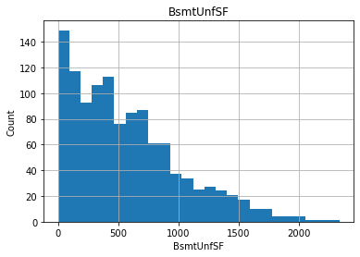
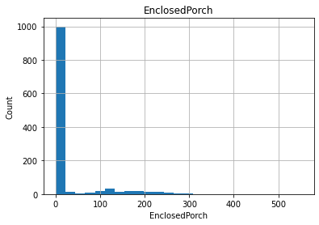
Histogram of BSmmtunfsf
Histogram of EnclosedPorch

Slide 36
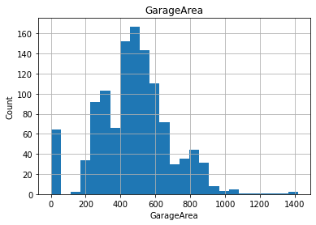
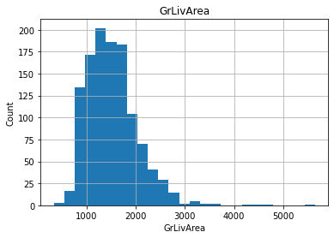
Histogram of GarageArea
Histogram of GrlivArea

Slide 37
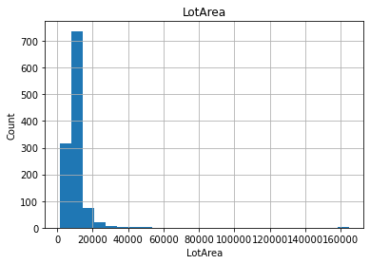
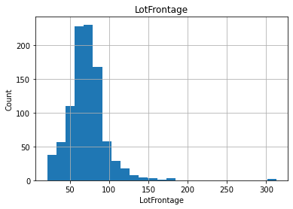
Histogram of LotArea
Histogram of LotFrontage

Slide 38
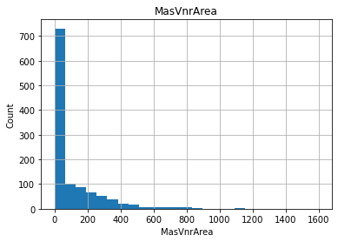
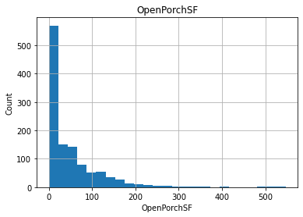
Histogram of MassvnArea
Histogram of OpenPorchSF

Slide 39
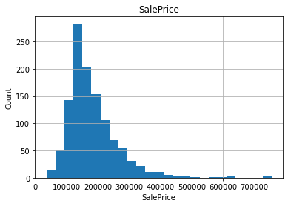
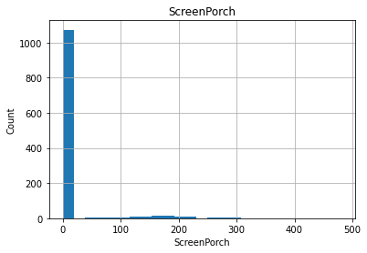
Histogram of SalePrice
Histogram of ScreenPorch

Slide 40
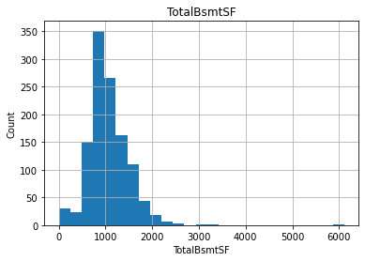
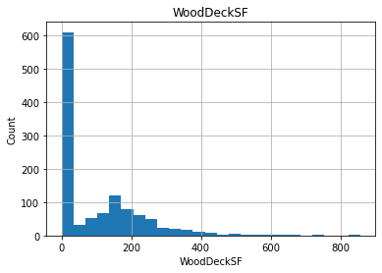
Histogram of TotalBsmtSF
Histogram of WoodDeckSF
Observation:-1. Most of the features are right skewed
2.Need to go to transformation

Slide 41
Log transformation can be done using the following python code:-
for feature in continous_feature:
data=df.copy()
if 0 in data[feature].unique():
pass
else:
data[feature]=np.log(data[feature])
data['SalePrice']=np.log(data['SalePrice'])
plt.scatter(data[feature],data['SalePrice'])
plt.xlabel(feature)
plt.ylabel('SalesPrice')
plt.title(feature)
plt.show()

Slide 42
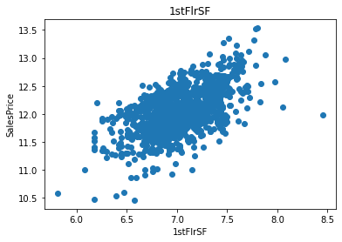
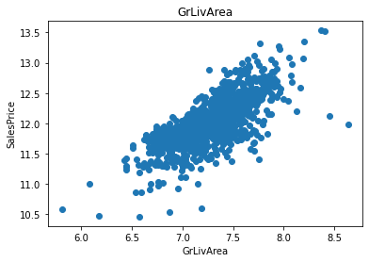
Saleprice vs 1StFlrSF
Saleprice vs GLivArea

Slide 43


Saleprice vs GLivArea
SalePrice Vs LotFrontage

Slide 44

SalePrice vs SalePrice

Slide 45
To check the outliers we are using the box plot.
for feature in continous_feature:
data=df.copy()
if 0 in data[feature].unique():
pass
else:
data[feature]=np.log(data[feature])
data.boxplot(feature)
plt.ylabel(feature)
plt.title(feature)
plt.show()
Observation:-There are lot of outliers therefore outlier treatment is required.
Realation Between categorical feature and SalePrice

Slide 46


Salepice Vs Alley
SalePrice Vs BldgType

Slide 47


SalePrice Vs BSmt Cond
SalePrice Vs BsmtExposure

Slide 48


SalePrice VS BsmtFinType1
SalePrice VS BsmtQual

Slide 49


Saleprice vs BsmtFinType2
SalePrice Vs Central Air

Slide 50


SalePrice Vs Condition2
SalePrice Vs Condition1

Slide 51


Saleprice Vs Exterior2nd
Saleprice Vs Electrical

Slide 52


Saleprice Vs ExterCond
SalePrice Vs Exterior 1st

Slide 53


SalePrice VS ExteriorQual
SalePrice Vs Fence

Slide 54


SalePrice Vs FirePlaceQU
SalePrice Vs Foundation

Slide 55


SalePrice Vs Functional
SalePrice Vs GarageType

Slide 56


SalaryPrice Vs Garagecond
SalePrice Vs GargeFinish

Slide 57


SalePrice Vs GarageQual
SalePrice Vs Heating

Slide 58


SalePrice Vs HeatingQC
SalePrice Vs HouseStyle

Slide 59


SalePrice VS KitchenQual
SalePrice Vs LandContour

Slide 60


SalePrice Vs LotConfig
SalePrice VS LandSlope

Slide 61


SalePrice Vs Lotshape
SalePrice Vs MiscFeature

Slide 62


SalePrice vs MSZoning
SalePrice vs neighbourhood

Slide 63


SalePrice Vs Paved Drive
SalePrice vs Poolqc

Slide 64


SalePrice vs RootStyle
SalePrice Vs RootMati

Slide 65


SalePrice Vs SaleType
SalePrice V Street

Slide 66


Saleprice Vs Utillities
SalePrice vs Sale Condition

Slide 67
Missing value can be replaced by the word Missing in Feature Engineering using Python code:
def replace_cat_feature(df, features_nan):
data=df.copy()
data[features_nan]=data[features_nan].fillna('Missing')
return data
df=replace_cat_feature(df, features_nan)
df[features_nan].isnull().sum()

Slide 68
Missing values present in Numerical Variables can replaced by the word Missing using the following python code:-
for feature in numerical_with_nan:
median_value=df[feature].median()
df[feature+'nan']=np.where(df[feature].isnull(),1,0)
df[feature].fillna(median_value,inplace=True)
df[numerical_with_nan].isnull().sum()

Slide 69
Extracting the new Feature from Date time Variable using the following Python code:-
for feature in ['YearBuilt','YearRemodAdd','GarageYrBlt']:
df[feature]=df['YrSold']-df[feature]
Make the logTransformation to remove the Right skewness in the histogram using the following python code:- in the features 'LotFrontage', 'LotArea', '1stFlrSF', 'GrLivArea', 'SalePrice' , outliers are present

Slide 70
num_features=['LotFrontage', 'LotArea', '1stFlrSF', 'GrLivArea', 'SalePrice']
for feature in num_features:
df[feature]=np.log(df[feature])
Categorical Encoding:- after outliers, skewness is removed using boxplot, log transformation, We are using Label Encoder to label from categorical to numerical using the following code:-
from sklearn.preprocessing import LabelEncoder
labelencoder=LabelEncoder()
for feature in categorical_features:
df[feature]=labelencoder.fit_transform(df[feature])

Slide 71
Missing value present in the test data can be removed using the python code:-
for feature in numerical_with_nan_test:
median_value=df1[feature].median()
df1[feature+'nan']=np.where(df1[feature].isnull(),1,0)
df1[feature].fillna(median_value,inplace=True)
df1[numerical_with_nan_test].isnull().sum()

Slide 72
Similarly as in the train data, Extract the Date Time Variable using following the python code:-
## Date Time Variables
for feature in ['YearBuilt','YearRemodAdd','GarageYrBlt']:
df1[feature]=df1['YrSold']-df1[feature]
Feature 'LotFrontage', 'LotArea', '1stFlrSF', 'GrLivArea' have the missing value. It can be handled by using log transformation
num_features_test=['LotFrontage', 'LotArea', '1stFlrSF', 'GrLivArea']
for feature in num_features_test:
df1[feature]=np.log(df1[feature])
similarly after removing the skewness, we are using the LabelEncoder to convert categorical to numerical using the following python code:-
for feature in categorical_features_test:
df1[feature]=labelencoder.fit_transform(df1[feature])

Slide 73
Feature Scaling
Feature Scaling:-
We are using the Min Max scaler for Scaling purpose:-
from sklearn.preprocessing import MinMaxScaler
scaler=MinMaxScaler()
after applying the MinMax Scaler, we are dividing the train and test data using the follow python code:-
y_train=df[['SalePrice']]
x=df.drop(['Id', 'SalePrice'], axis=1)

Slide 74
# importing modules
from sklearn.model_selection import train_test_split
from sklearn.linear_model import LinearRegression
from sklearn.svm import SVR
from sklearn.linear_model import Ridge
from sklearn.ensemble import RandomForestRegressor
from sklearn.ensemble import AdaBoostRegressor
from sklearn import metrics
#Splitting the data into input and output variable.
x=df.drop(columns=['SalePrice','Id'],axis=1)
y=data['SalePrice']
#Splitting the data into training and testing data
from sklearn.model_selection import train_test_split
x_train,x_test,y_train,y_test=train_test_split(x,y,test_size=.25,random_state=42)

Slide 75
Regression Techniques used:-
1.Linear Regression
2. SVR Regression
3.Ridge Regression
4.Decision Tree Regression
5.Random Forest Regression

Slide 76
Checking cross val score
Here our Ridge Regression model performs well. So we will do HyperParameter Tuning for Ridge Regression
# passing the created parameters to GridSearchCV
GCV = GridSearchCV(Ridge(), param_grid, cv=kfold)
GCV.fit(x_train, y_train)
# building the model with best parameters
tuned_model = Ridge(alpha=0.1, fit_intercept='True', normalize='True', solver='sparse_cg')
tuned_model.fit(x_train, y_train)
prediction = tuned_model.predict(x_test)
# printing r2 score for the target variable Sale Price
print("r2 score: {:.4f}".format(metrics.r2_score(y_test, prediction)))

Slide 77
Saving our model
# importing joblib
import joblib
joblib.dump(tuned_model, 'PFAHOUSINGPROJECT.pkl')
Loading test csv file
# predicting the sale price of the test dataset using the model we used in hyperparameter tuning.
prediction1 = tuned_model.predict(test_new)

Slide 78
Conclusion
Ridge Regression model is considered as the best model among 5 because of
Mean Absolute Error: 0.08378552638145562
Mean Squared Error: 0.01481033608791579
Root Mean Squared Error: 0.12169772425117817
r2 score: 0.9134148704413022

